Slide 1
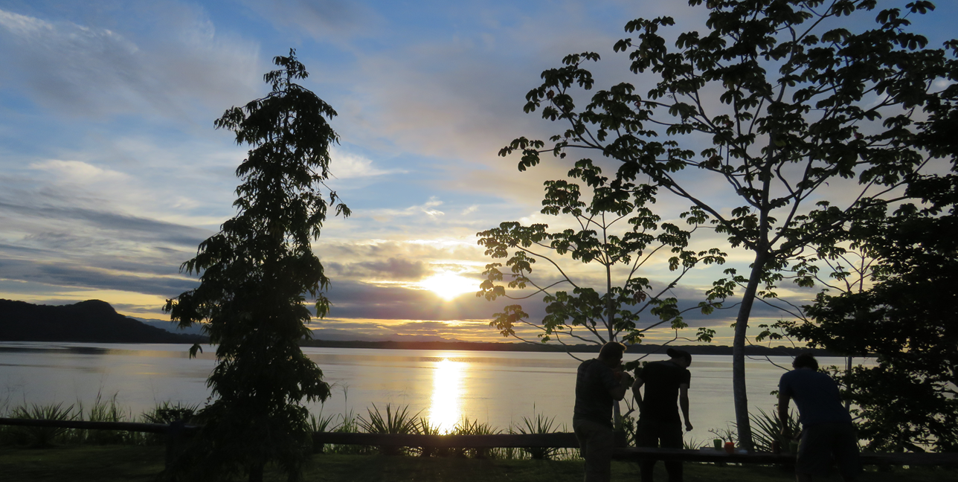
Program and characteristics of the activities during the experience of academic tourism in BFI's students of WPI, from 02 to 11-09-18 Coordination of Batipa Field Institute

Slide 2
An academic tourism experience in the western region of Panama
Program and characteristics of the activities during the Academic Tourism experience in BFI of WPI Students, from 02 to 11-09-18
Sunday 02-09-18 Transfer from the Enrique Malek International Airport (https://es.wikipedia.org/wiki/Aeropuerto_Internacional_Enrique_Malek) to the Gran Vía Hotel (http://www.granviahotel.net/)
Monday 03-09-18: Visit to the Technological University OTEIMA (http://www.oteima.ac.pa/web3/) and meeting with the Rector Nixa Gnaegi de Rios for words of welcome and presentation of institutional information and of the region useful for your visit, dinner at a local restaurant.
Visit to Finca BATIPA: making a preliminary tour to provide experiential information about the work area visiting the Archaeological Area, Plantation and Processing of Teak and Puerto de Cabimos in the Chiriqui Gulf Park, transfers made in Toyota Prado 4x4 vehicle with 7 posts .

Slide 3
An academic tourism experience in the western region of Panama

Slide 4
An academic tourism experience in the western region of Panama
Tuesday 04-09-18: Visit and attention by the staff of the portable sawmill, to know the processing of the thinning teak and return to the OTEIMA Technological University (UTO). This processing is considered an alternative to generate new products for sale with added value, for the wood thinning that takes place during the growth of the trees and obtaining the final product of commercialization at 20 years.

Slide 5
An academic tourism experience in the western region of Panama

Slide 6
An academic tourism experience in the western region of Panama

Slide 7
An academic tourism experience in the western region of Panama

Slide 8
An academic tourism experience in the western region of Panama

Slide 9
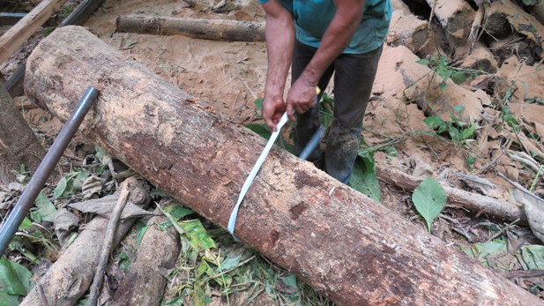
An academic tourism experience in the western region of Panama

Slide 10
An academic tourism experience in the western region of Panama
Wednesday 05-09-18: visit and attention by the manager of GANADERA BATIPA and the reforestation company DABSA, Ing., Luis Rios Gnaegi, for the exchange of information in the field on the management of the cattle ranch and the plantations of teak, under the silvopastoral model and regeneration of plant succession, respectively, for coexistence with the Private Wildlife Reserve Cerro BATIPA of 600ha and the mangrove area of ​​the surrounding 2000ha, both eco-friendly economic activities with their environment.
In the facilities of the Bovine Reproduction Laboratory of the subsidiary company CIGRAS, specialized in assisted reproduction, dinner at La Barqueta beach overlooking the sea.

Slide 11
An academic tourism experience in the western region of Panama

Slide 12
An academic tourism experience in the western region of Panama

Slide 13
An academic tourism experience in the western region of Panama
06-09-18: visit to the Altitudinal Biological Corridor of Gualaca(CBAG) that extends from the Gulf of Chiriqui-BATIPA to the Forest Reserve of Fortuna where the Fortuna Hydroelectric Plant of ENEL is located, visit to the local lodges in the CBAG and Erosion problems in intervened areas. (https://www.reservaforestalfortuna.com/hidroelectrica-fortuna)

Slide 14
An academic tourism experience in the western region of Panama

Slide 15
An academic tourism experience in the western region of Panama

Slide 16
An academic tourism experience in the western region of Panama

Slide 17
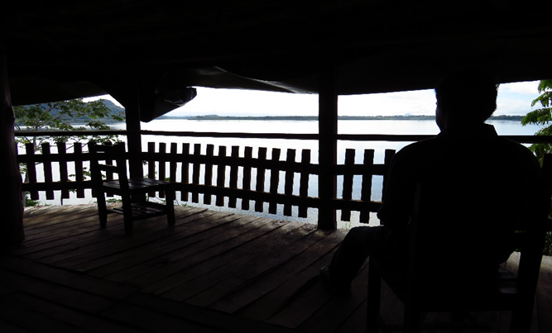
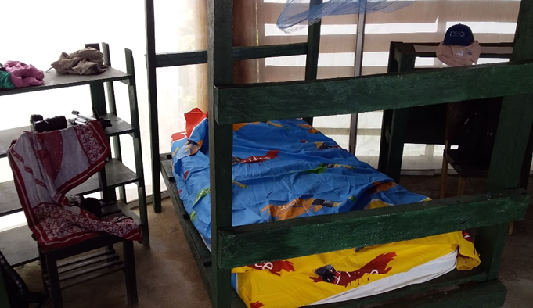
An academic tourism experience in the western region of Panama
08 and 09-09-18: Lodging area in the Gulf of Chiriqui between the Bay of the Dead in the accommodation of CABIMOS, plantations of Teak and native vegetation, headquarters of the area of ​​lodging and aquatic activities:

Slide 18
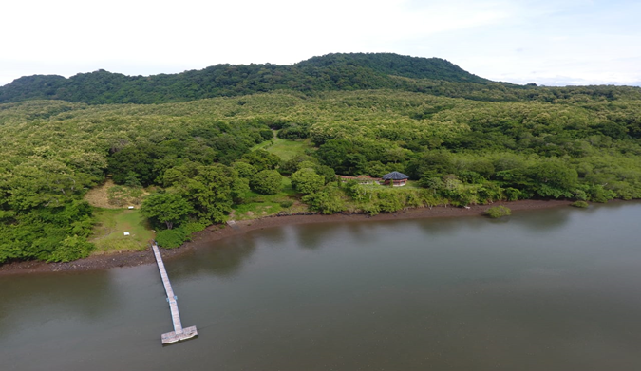
An academic tourism experience in the western region of Panama

Slide 19
An academic tourism experience in the western region of Panama
08-09-18: Visit and boarding in the marina of Puerto Pedregal in the mangrove zone of DAVID, to travel through the Coastal Marine Route of the Chiriqui Gulf National Park, transit Puerto Pedregal-Isla GAMES – Bahía of the Dead in BATIPA. (http://cpps.dyndns.info/cpps-docs-web/planaccion/biblioteca/pordinario/090.PCA-POP%20baja-Panama-2009.pdf)

Slide 20
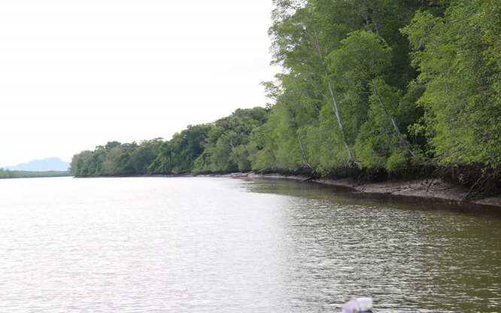
An academic tourism experience in the western region of Panama

Slide 21
An academic tourism experience in the western region of Panama
Isla GAMEZ: Corresponding to the archipelago of islands that make up the Gulf of Chiriqui National Marine Park, here we enjoyed white beaches and turquoise waters consuming typical food of the area, interacting with students of the OTEIMA Technological University.

Slide 22
An academic tourism experience in the western region of Panama

Slide 23
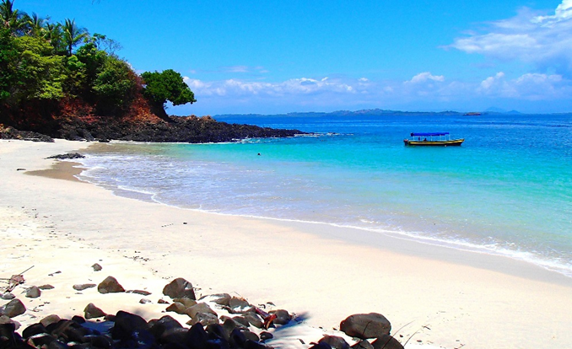
An academic tourism experience in the western region of Panama

Slide 24
An academic tourism experience in the western region of Panama
09-09-18: Lodging in the Cabimos with the personnel for the attention of the guests, in typical structures of wood with thatched roof to the use of the zone, in a natural environment with comfortable services, drinking water of spring and typical Panamanian cuisine.
Typical barbecue dinner and breakfast with abundant tropical fruits of the area. Outdoor activities such as fishing, horseback riding with the staff of the cattle ranch, and kayak tours through the pristine wetlands of BATIPA and sightings of wildlife.

Slide 25
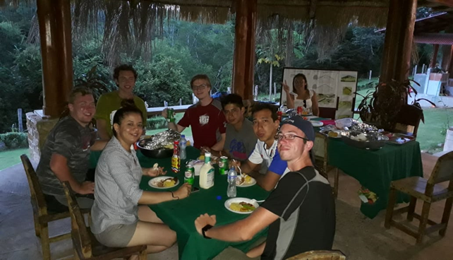
An academic tourism experience in the western region of Panama

Slide 26
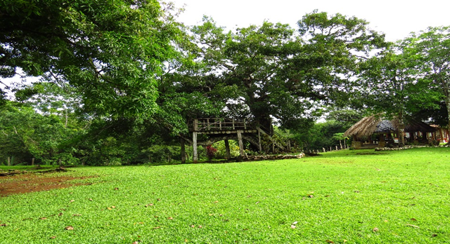
An academic tourism experience in the western region of Panama

Slide 27
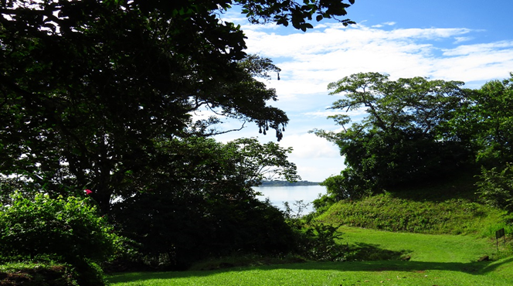
An academic tourism experience in the western region of Panama

Slide 28
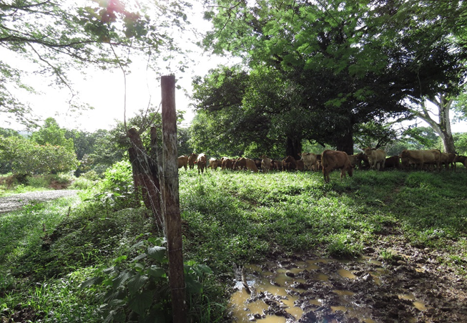
An academic tourism experience in the western region of Panama

Slide 29
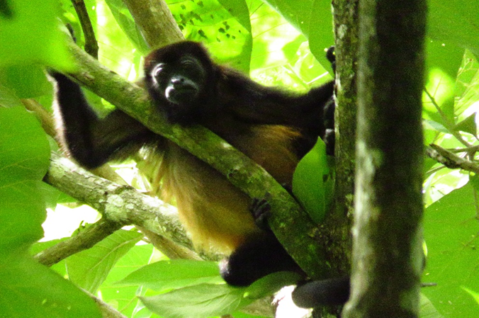
An academic tourism experience in the western region of Panama

Slide 30
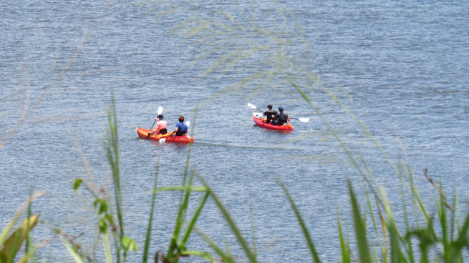
An academic tourism experience in the western region of Panama

Slide 31
An academic tourism experience in the western region of Panama
10 and 11-09-18: Preparation of a video about the BATIPA Experience, preparation of presentation and exchange of information on ideas for the document to be presented.

Slide 32
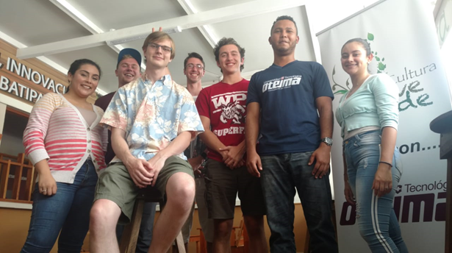
An academic tourism experience in the western region of Panama

Slide 33
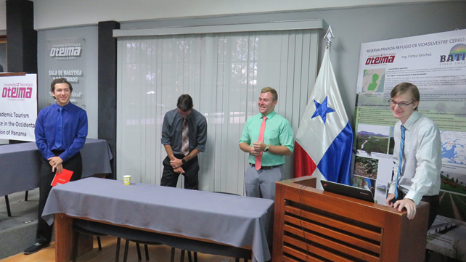
An academic tourism experience in the western region of Panama

Slide 34
An academic tourism experience in the western region of Panama

Slide 35
WPI-OTEIMA…THE TEAM!!!!

